Slide 1
Personal fitness lesson #3
TERMINOLGY

Slide 2
The 5 Components of fitness
Cardiorespiratory Endurance
Muscular Strength
Muscular Endurance
Flexibility
Body Composition

Slide 3
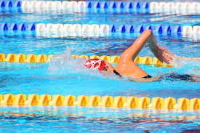
Cardiorespiratory endurance
The ability of the heart and lungs to absorb, transport and utilize oxygen over an extended period of time during physical exertion.

Slide 4
AEROBIC & ANAEROBIC
Aerobic- w/ oxygen
Anaerobic- w/o oxygen
Exercise that improves the efficiency of the body’s cardiovascular system in absorbing and transporting oxygen
Examples:
Spinning, running, swimming, dancing and kickboxing
Exercise that does not improve the efficiency of the body’s cardiovascular system in absorbing and transporting oxygen
Examples:
Heavy weight training

Slide 5
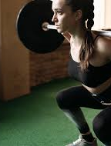
MUSCULAR STRENGTH
Refers to the amount of force a muscle can produce with a single maximal effort.

Slide 6
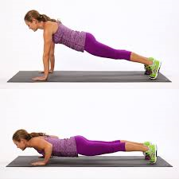
MUSCULAR ENDURANCE
The ability of a muscle or group of muscles to sustain repeated contractions against a resistance for an extended period of time.

Slide 7
flexibility
The range of motion of your joints and the ability of your joints moving freely
Flexibility will help reduce the chance of an injury

Slide 8
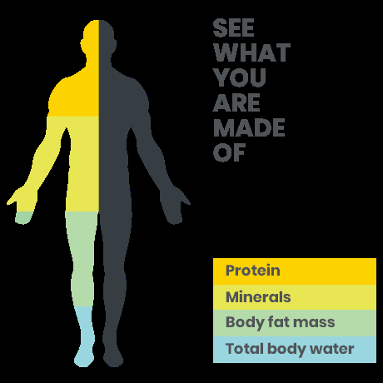
Body Composition
Used to describe the percentages of fat, bone, water and muscle in human bodies.

Slide 9
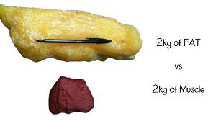
Look at your composition, not the number on the scale!
Why?
Your body is made up of two things fat and non-fat (put these two things together and that makes up your weight)
Fat are your essential fats and excess fats
Non fat are your muscles and bones
Your weight does not always indicate how healthy you are
Muscle does not weigh more than fat because…a pound is pound!
Muscle is more dense though than fat is so it seems “heavier”.
A pound of muscle will take up much less space than a pound of fat

Slide 10
Why it is good to increase muscle mass
WEIGHT CONTROL→ muscle mass is a calorie burning machine
By strength training and increasing your muscle mass your body will then burn more calories and you will lose weight
The more tone you are the easier it is to maintain your weight
Burning calories at rest???
1 lb. of muscle burns 7-10 calories a day
1 lb. of fat burns 2-3 calories a day
INCREASED STRENGTH→ by having more strength you will have a more active lifestyle
REDUCED RISK OF INJURY→ Building muscle will help protect your joints around it from getting injured
INCREASE YOUR SELF ESTEEM→ being tones and strong will help your appearance which in turn will make you feel better

Slide 11
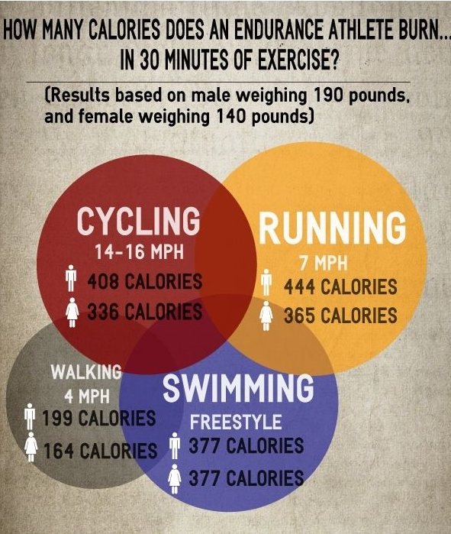
Are women “fattier” than men? (Read that question carefully and closely)
YES (and it is not a bad thing)…
Women generally (not always) have a higher percentage of body fat than men
Women- 25% and Men- 15%
Women also require fewer calories per pound of body weight than men
Another factor are female hormones
Losing weight
Men have more lean muscle tissue which in turn means that they burn more calories
So if men and women cut the same calories… who will lose more weight?

Slide 12
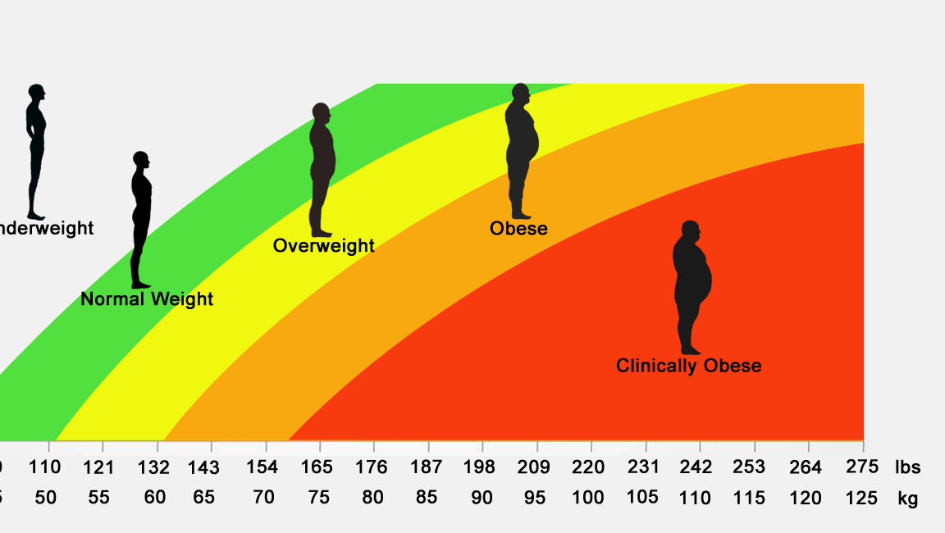
What is bmi?
Body Mass Index→ a weight to height ratio calculated by dividing one’s weight in kilograms by the square of one’s height in meters and it is used as an indicator or obesity or being underweight

Slide 13
What types of training will increase muscle and reduce fat?
CIRCUIT TRAINING→ its a form of conditioning; it targets strength building or muscular endurance. An exercise “circuit” is one completion of all prescribed exercises in the program
INTERVAL TRAINING→ training in which an athlete alternates between two activities, typically requiring different rates of speed and degree of effort
RESISTANCE TRAINING→ strength training is a type of physical exercise specializing in the use of resistance to induce muscular contraction which builds strength, anaerobic endurance and the size of skeletal muscles.

Slide 14
CIRCUIT TRAINING SAMPLE

Slide 15
Interval training sample

Slide 16
Resistance training sample

Slide 17
CONCLUSION
WHAT IS SOMETHING NEW THAT YOU LEARNED TODAY?
WHAT ARE THE KEY TAKE-AWAYS FROM TODAY’S LESSON?

